Slide 1
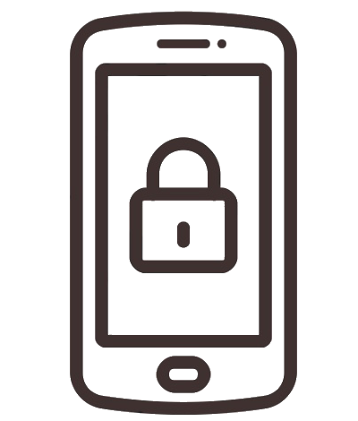
Mobile Device Security
Lorrin Johnson

Slide 2
Table of Contents
Introduction to Service-Learning
Mobile Device Security
Introduction to mobile device security
Mobile device security importance
Benefits of mobile device security
Last Thoughts and Helpful Tips
Contact Information
References
Frequently Asked Questions
Mobile device security best practices
Types of mobile device security
Maintaining security

Slide 3
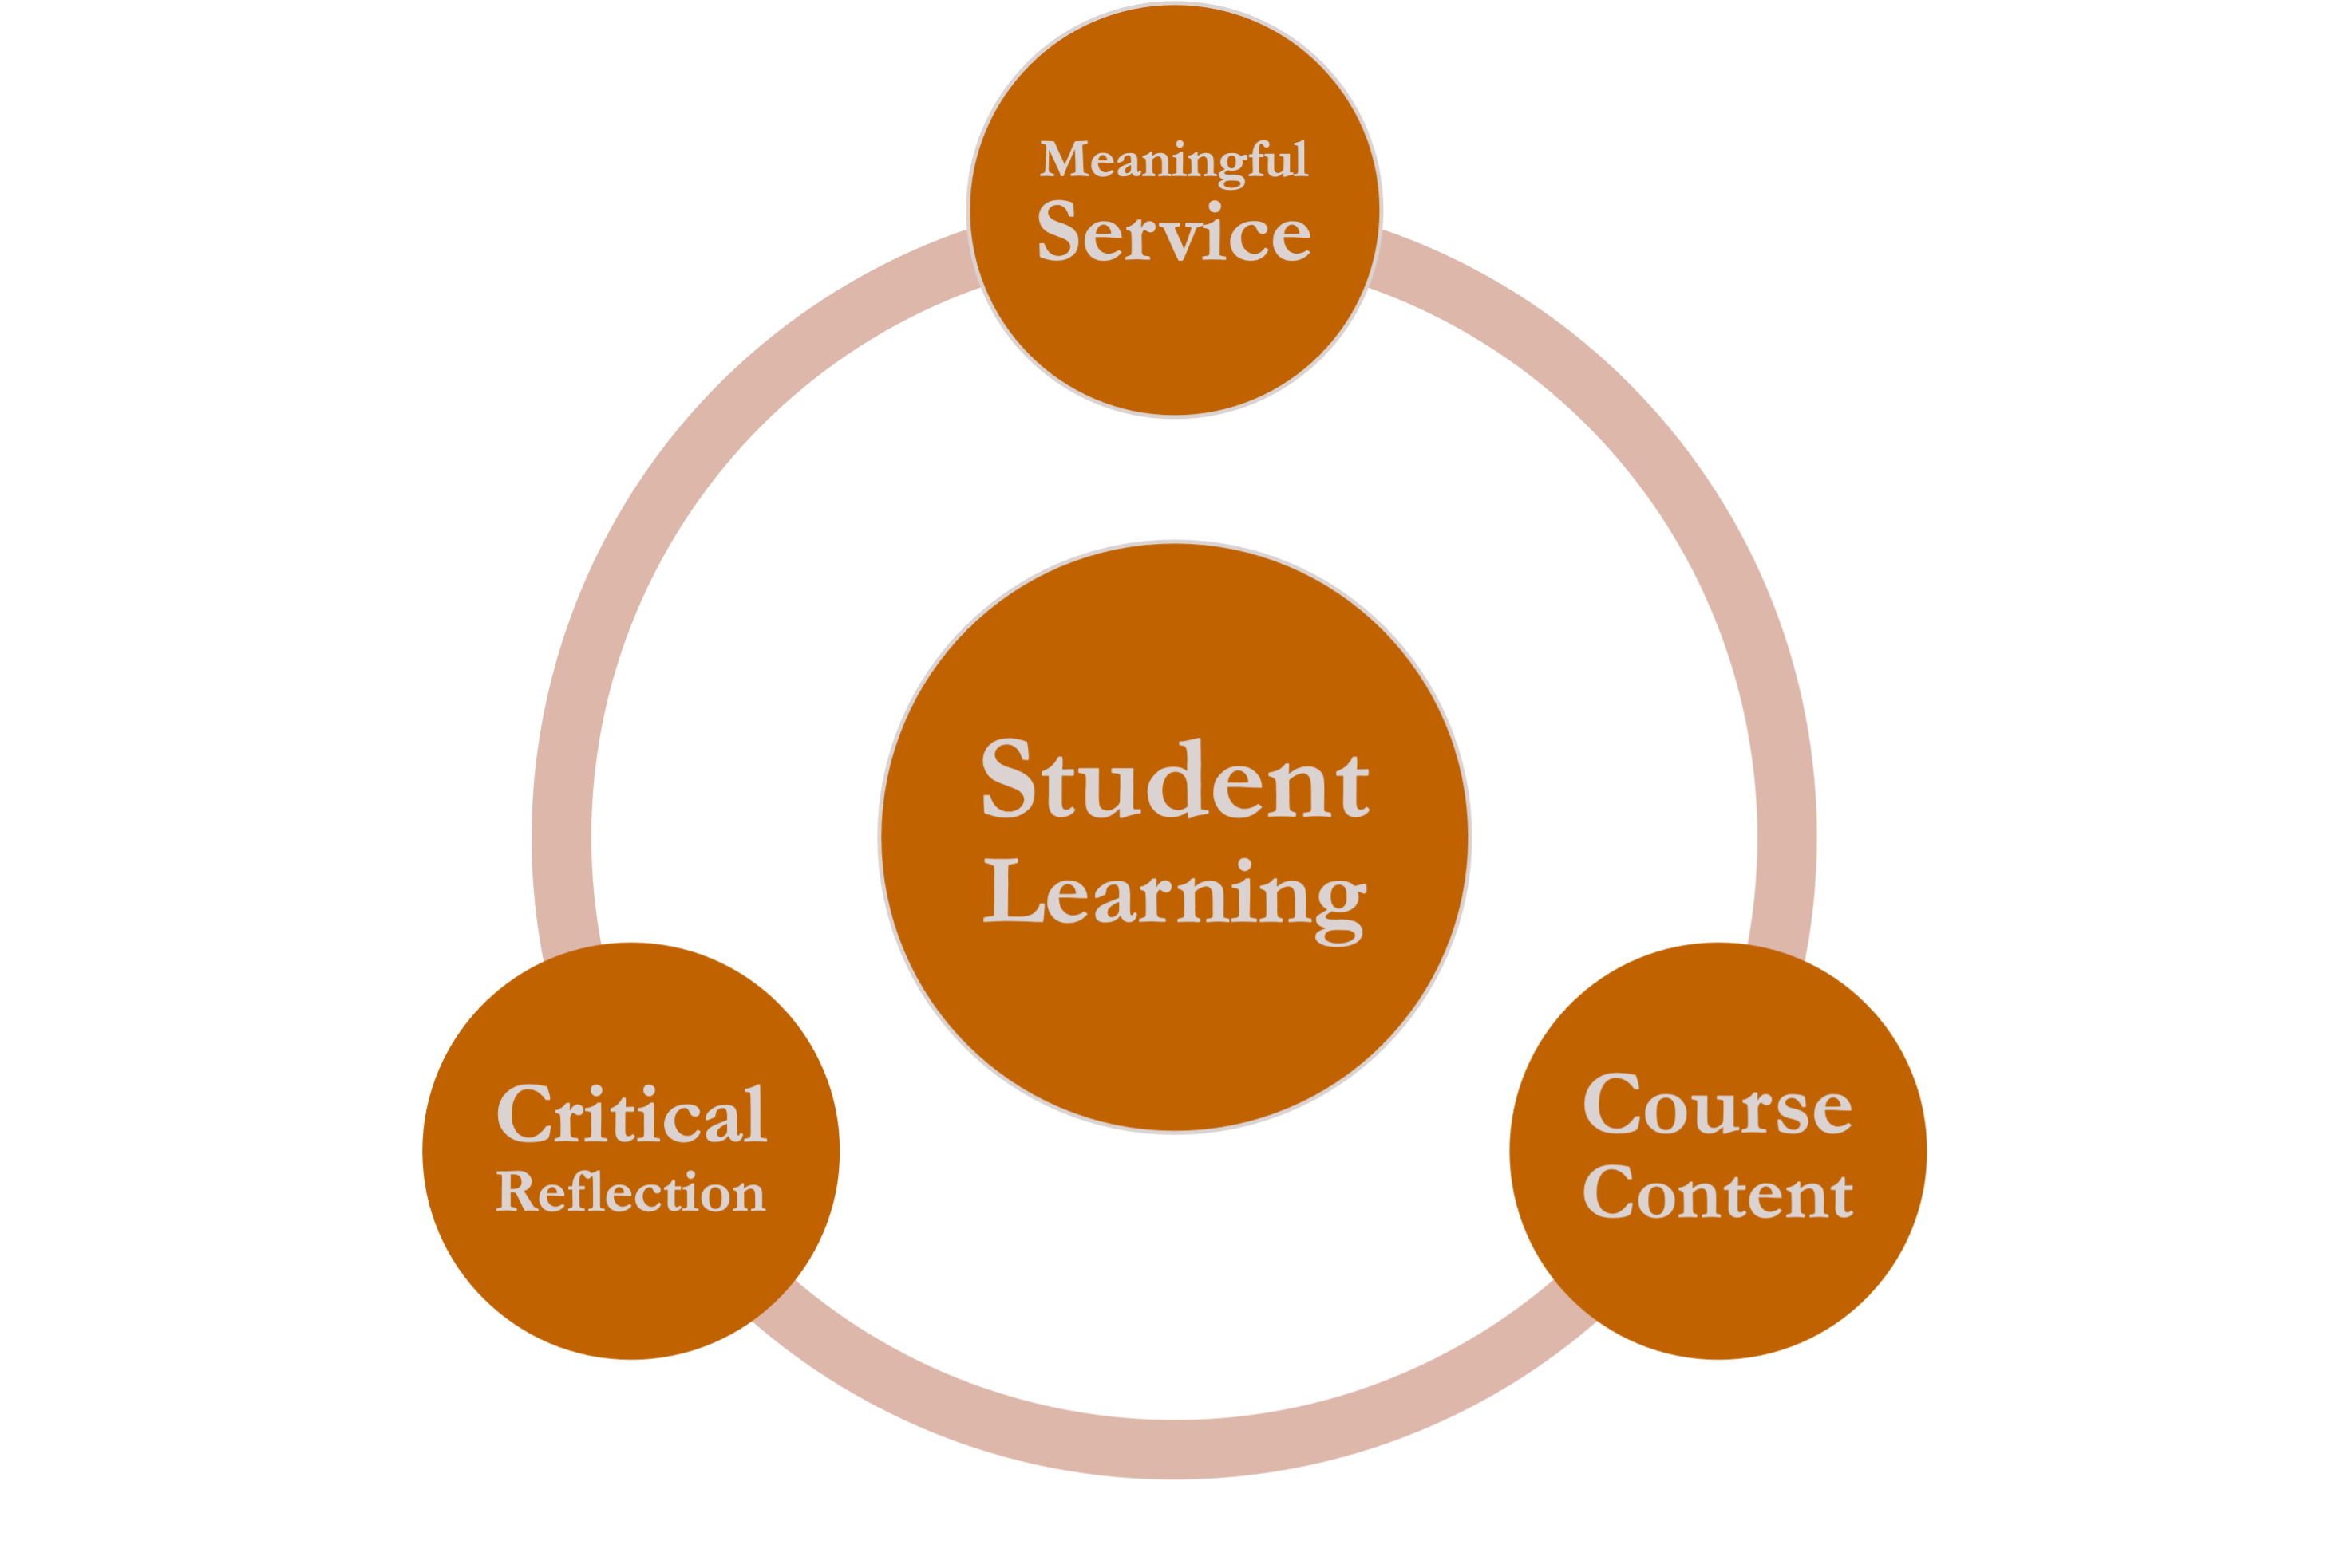

Introduction to Service-Learning
Service-learning engages students in direct service, reflection, and integration as an essential part of the course learning objectives.
Working in data analytics, technology is our primary resource.
Any interruptions in our process would cause several issues so it is important to maintain secure devices through best practices.

Slide 4
Introduction to Mobile Device Security
Mobile device security includes the measures designed to protect sensitive information stored on and transmitted by laptops, smartphones, tablets, and other portable devices.
The goal is to keep unauthorized users from accessing the network.

Slide 5
Mobile Device Security Importance
As mobile devices become more popular in the workplace, distinct challenges to network security are present.
Potential threats to mobile devices:
Malicious mobile applications
Data leaks
Scams from phishing
Spyware
Unsecure Wi-Fi networks
Insider threats, intentional and unintentional

Slide 6
Benefits of Mobile Device Security
Regulatory compliance
Enforcement of security policy
Incorporation of BYOD – bring your own device
Device updates controlled remotely
Control of applications
Device registration automation
Automated data backup
Protects from malicious attacks from being able to access sensitive information from the organization

Slide 7
Mobile Device Security Best Practices
Establish, share and enforce clear policies and procedures
Password protection and training
Incorporate the use of biometrics
Avoid public Wi-Fi
Beware of external applications
Mobile device encryption

Slide 8
Types of Mobile Device Security
Email Security
Endpoint protection
VPN – virtual private network
Secure web gateway
CASB - Cloud access security broker

Slide 9
Maintaining Security
Do's
Don'ts
Do not connect to public, and untrusted, Wi-Fi networks
Do not install several unnecessary applications or enter personal data
Do not perform work actions including sensitive information on personal devices
Do not jailbreak or root your mobile device
Update mobile device software and applications automatically or when available
Use strong and complex pins and passwords
Consider the use of biometric authentication
Protect devices with cases that help to drown microphones and block audio in the room
Do not connect to public, and untrusted, Wi-Fi networks
Do not install several unnecessary applications or enter personal data
Do not perform work actions involving sensitive information on personal devices
Do not jailbreak or root your mobile device

Slide 10
Last Thoughts/Helpful Tips
Always lock device when not in use
Don’t open suspicious emails from external addresses
Always back up mobile device data
Don’t download third-party applications without company approval
Always enable two-factor authentication
Don’t use the same password for every account

Slide 11
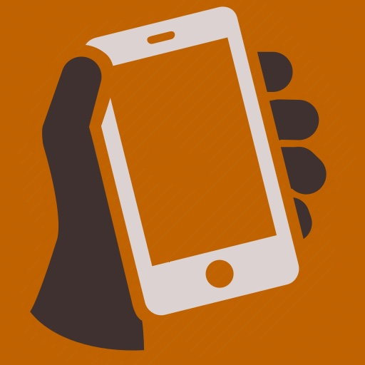

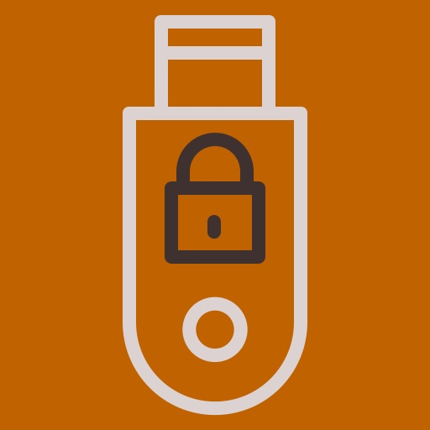

Frequently Asked Questions
What qualifies as a mobile device?
Any small device that can process and store data. Examples include laptops, smartphones, tablets, and PDAs.
What are the company password requirements?
This depends on the company, but usually a complex mix of at least eight characters.
Can I use an encrypted USB drive to store company data?
Most storage drives are accepted, but encryption must first be verified by the company.
What if my device is stolen?
Immediately report the incident so the device can be deactivated.

Slide 12
References
What Is Mobile Device Security? Cisco Small Business Resource Center. Source: https://www.cisco.com/c/en/us/solutions/small-business/resource-center/security/mobile-device-security.html
Mobile Device Best Practices. National Security Agency (NSA). Source: https://media.defense.gov/2021/Sep/16/2002855921/-1/-1/0/MOBILE_DEVICE_BEST_PRACTICES_FINAL_V3%20-%20COPY.PDF
Mobile Device Security FAQ. University of Florida, Information Security. Source: https://security.ufl.edu/resources/mobile-device-security/mobile-device-security-faq/

